Slide 1

Deep Learning seminar
Sergi Bernet Andrés
Sergi.bernet@salle.url.edu
DS4DS – La Salle
07-11/03/22

Slide 2
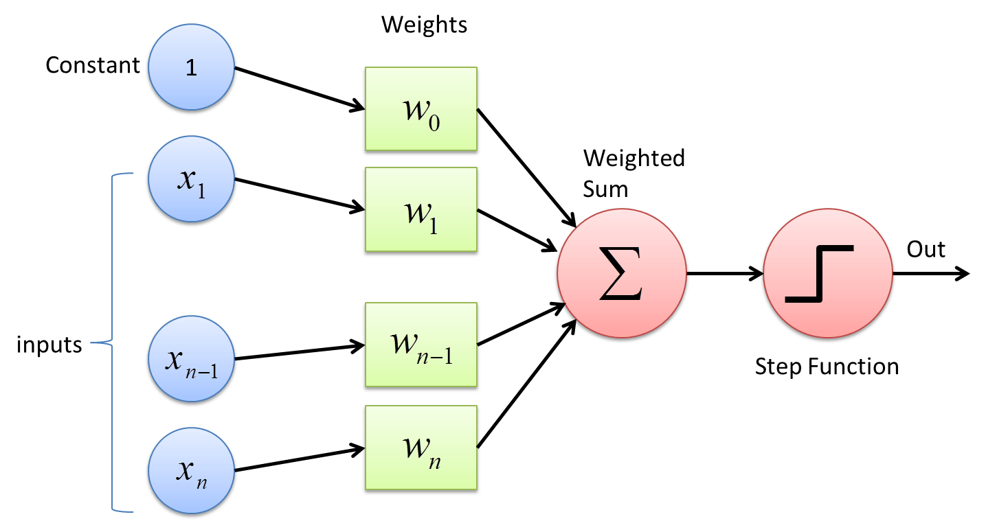
Backup
Perceptron as the basic neuron unit:
- Inputs
- Weights
- Activation function

Slide 3
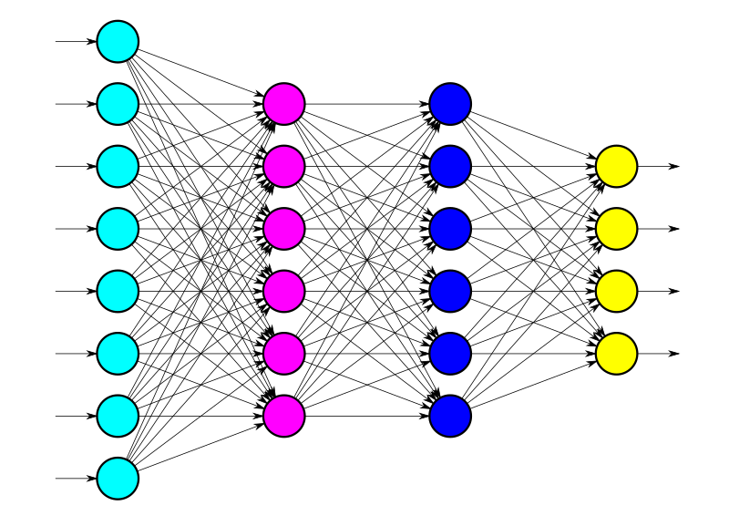
Backup
Perceptron as the basic neuron unit:
- Inputs
- Weights
- Activation function
Multi layer perceptron/Dense network as the evolution based on adding layers between our inputs and outputs.

Slide 4
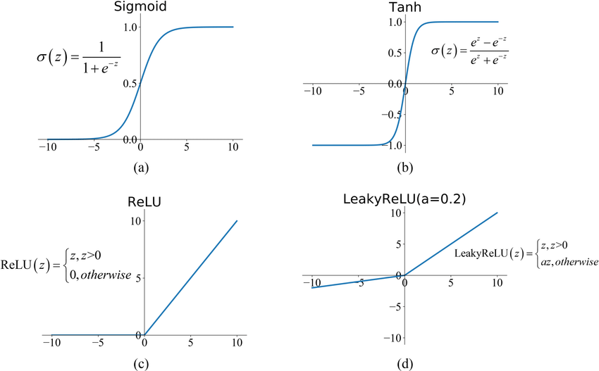
Backup
Activation functions in charge of the non-lineary of our models:
- ReLU or LeakyRelu in hidden layers.
- Careful with the selection for the output layer, depends directly on the problem we're solving!
- Objective feature: How many possible values?

Slide 5
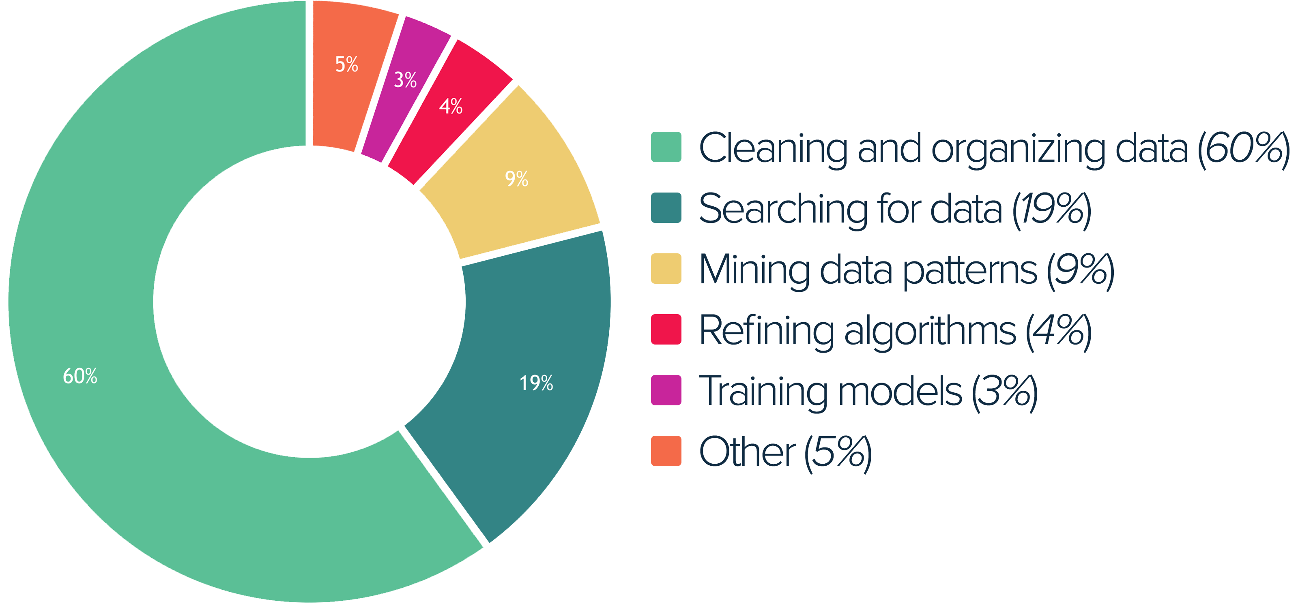
Backup

Slide 6
Backup
79%

Slide 7
Table of contents – Day 2
Convolution
What is a convolution and what does it look like, mathematical approach and more

Slide 8
Table of contents – Day 2
Signals/Vectors
Images
Convolution
Layers
Hands-on

Slide 9
Signals/Vectors

Slide 10
Signals
Function that contains information about a phenomenon such as voltage/current in electronics.

Slide 11
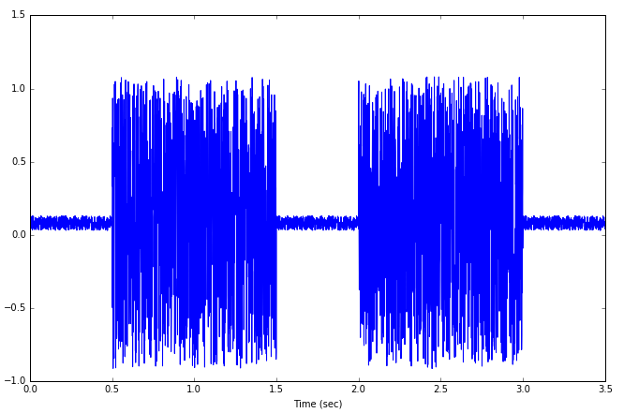
Signals
Function that contains information about a phenomenon such as voltage/current in electronics.

Slide 12
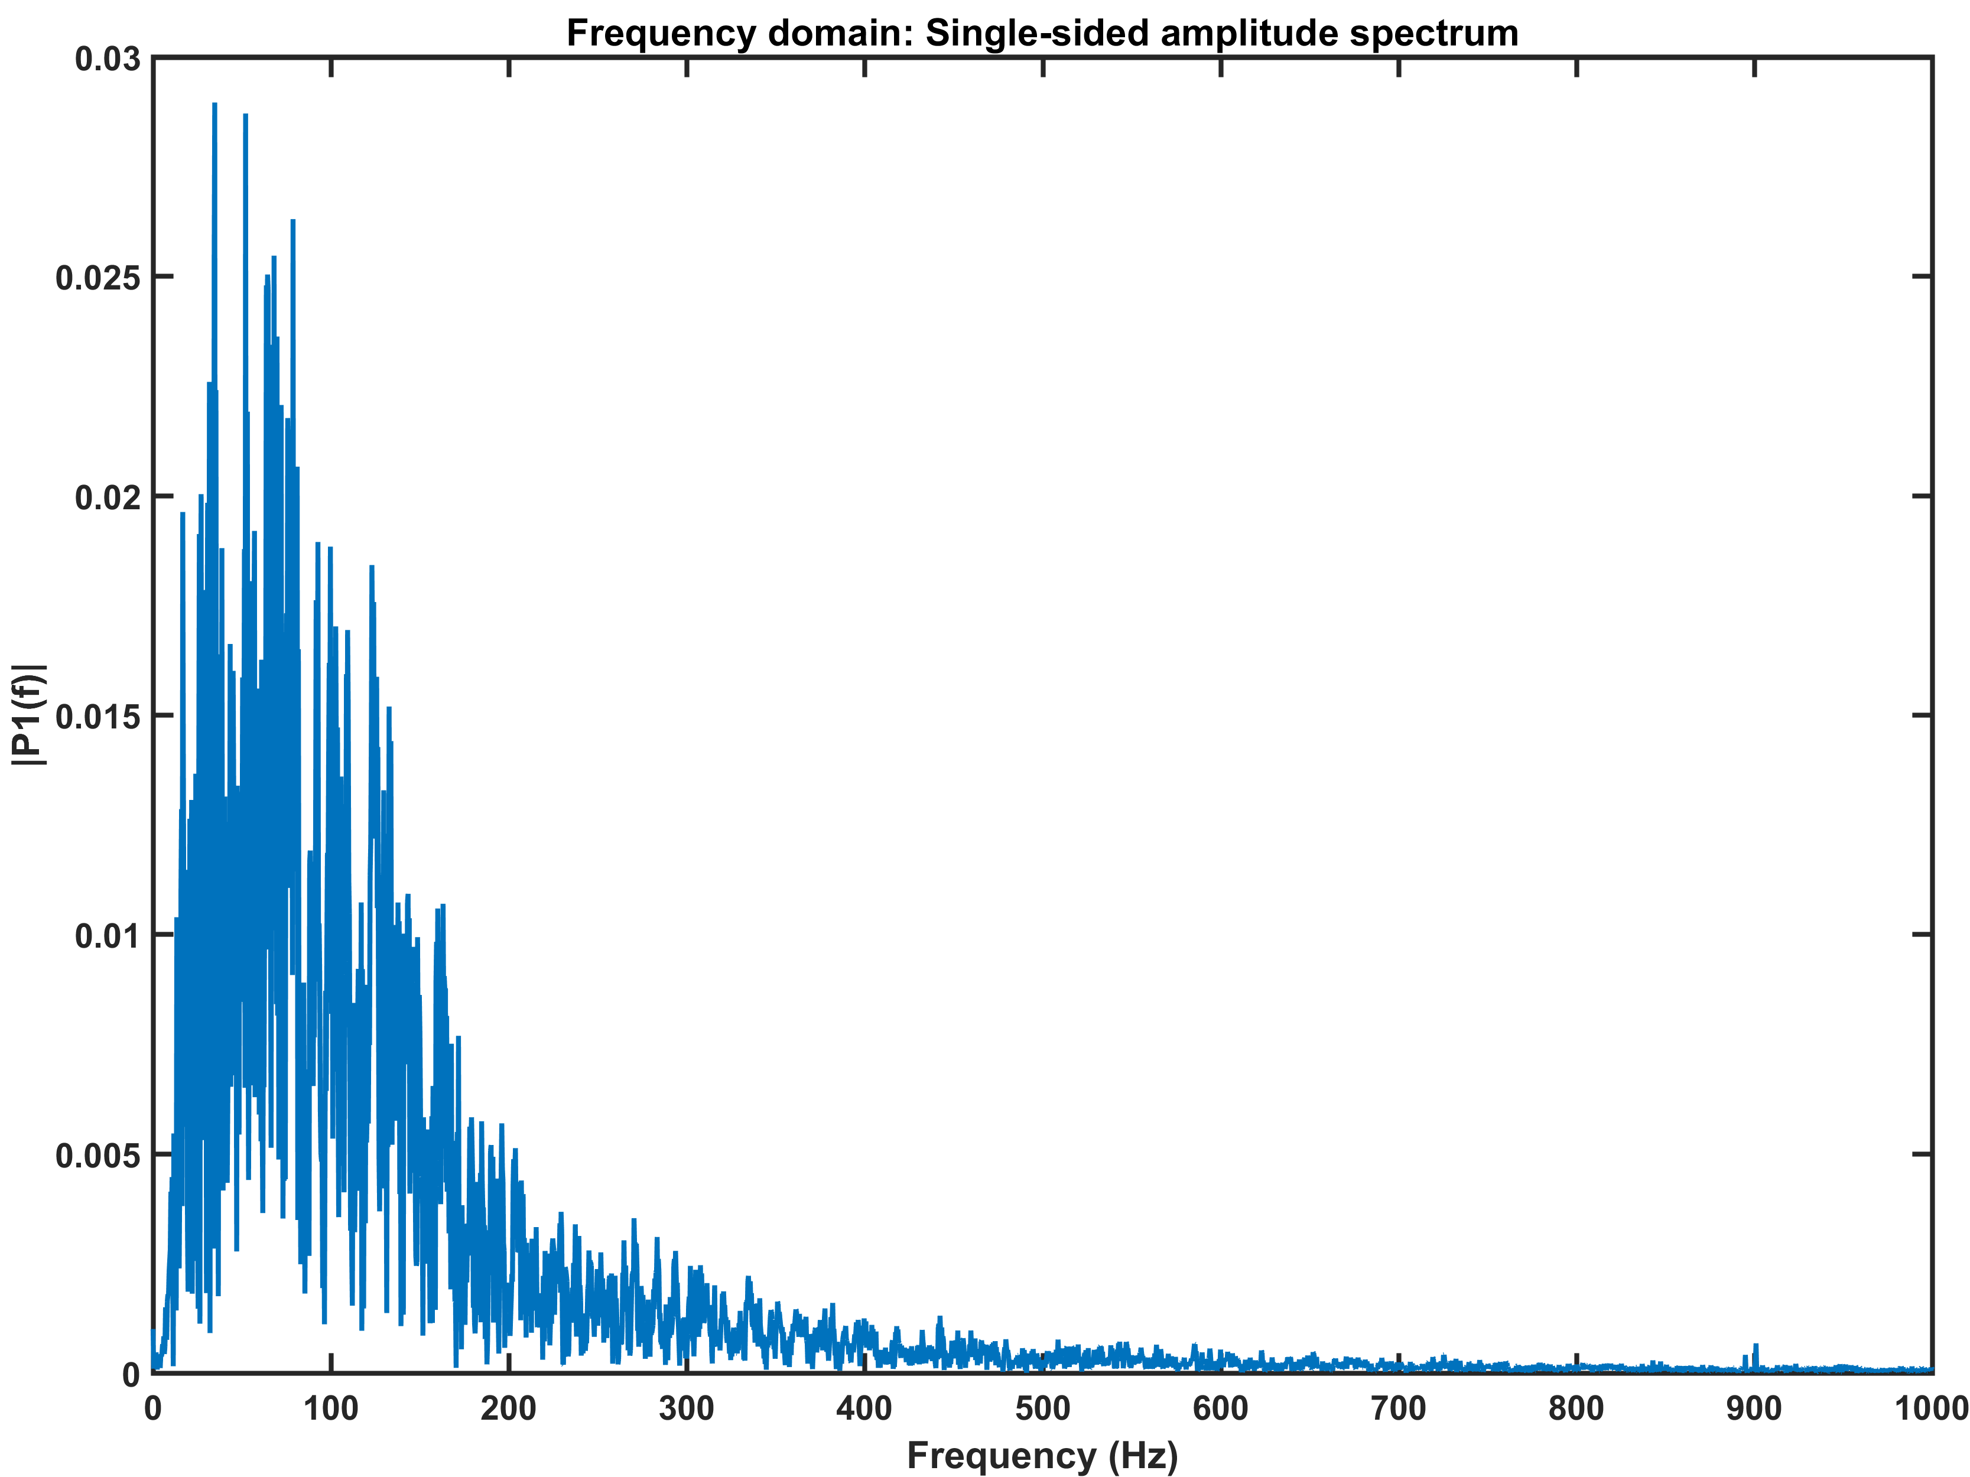
Signals
Function that contains information about a phenomenon such as voltage/current in electronics.

Slide 13
Signals
Function that contains information about a phenomenon such as voltage/current in electronics.
EMG

Slide 14
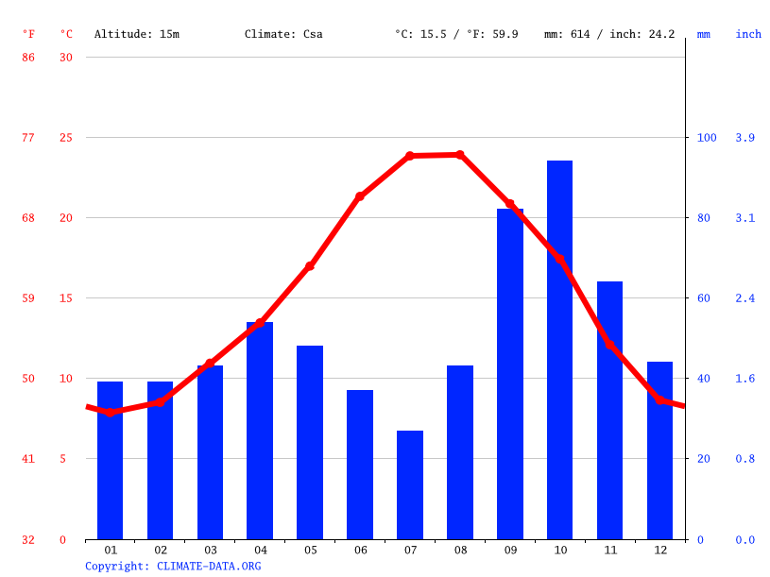
Signals
Function that contains information about a phenomenon such as voltage/current in electronics.
EMG

Slide 15
Signals
Function that contains information about a phenomenon such as voltage/current in electronics.
EMG
Barcelona weather forecasting

Slide 16
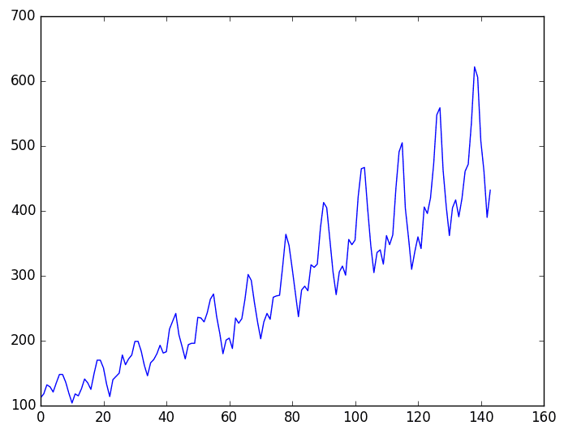
Signals
Function that contains information about a phenomenon such as voltage/current in electronics.
EMG
Barcelona weather forecasting

Slide 17
Signals
Function that contains information about a phenomenon such as voltage/current in electronics.
EMG
Barcelona weather forecasting
Air passengers dataset

Slide 18
Signals
Although images represent different data with different timestamp (horizontal axis) between samples all are a 1D vector.

Slide 19
Signals
Although images represent different data with different timestamp (horizontal axis) between samples all are a 1D vector.
vector2 = np.array([(i*np.random.normal(1, 0.2)+
np.random.random(1)) for i in range(50)])

Slide 20
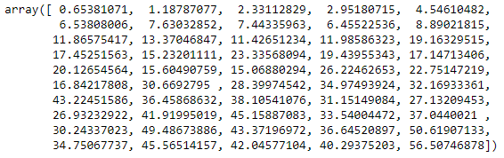
Signals
Although images represent different data with different timestamp (horizontal axis) between samples all are a 1D vector.
vector2 = np.array([(i*np.random.normal(1, 0.2)+
np.random.random(1)) for i in range(50)])

Slide 21
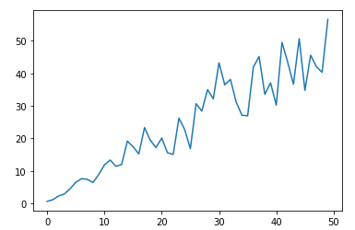
Signals
Although images represent different data with different timestamp (horizontal axis) between samples all are a 1D vector.
vector2 = np.array([(i*np.random.normal(1, 0.2)+
np.random.random(1)) for i in range(50)])

Slide 22
Images

Slide 23
Images
An image is an artifact that depicts visual perception, such as a photograph or other two-dimensional picture.

Slide 24
Images
An image is an artifact that depicts visual perception, such as a photograph or other two-dimensional picture.
- Binary
- Grayscale
- Coloured

Slide 25
Images
An image is an artifact that depicts visual perception, such as a photograph or other two-dimensional picture.
- Binary: 0/1 or -1/1
- Grayscale
- Coloured

Slide 26
Images
An image is an artifact that depicts visual perception, such as a photograph or other two-dimensional picture.
- Binary: 0/1 or -1/1
- Grayscale: 0 to 255, also rescaled between 0 to 1.
- Coloured

Slide 27
Images
An image is an artifact that depicts visual perception, such as a photograph or other two-dimensional picture.
- Binary: 0/1 or -1/1
- Grayscale: 0 to 255, also rescaled between 0 to 1.
- Coloured: 0 to 255 or rescaled (0 to 1) but with 3 channels.

Slide 28
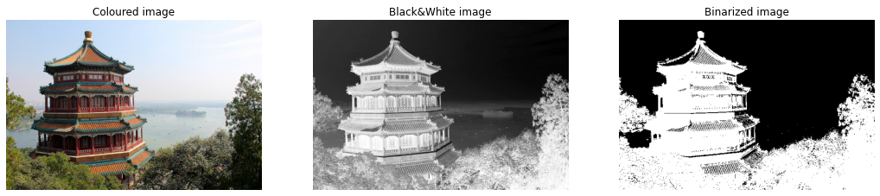
Images
An image is an artifact that depicts visual perception, such as a photograph or other two-dimensional picture.
- Binary: 0/1 or -1/1
- Grayscale: 0 to 255, also rescaled between 0 to 1.
- Coloured: 0 to 255 or rescaled (0 to 1) but with 3 channels.

Slide 29
Convolution

Slide 30
Convolution - Definition
Mathematical operation between two functions that describes how the shape of the first is modified by the other.

Slide 31
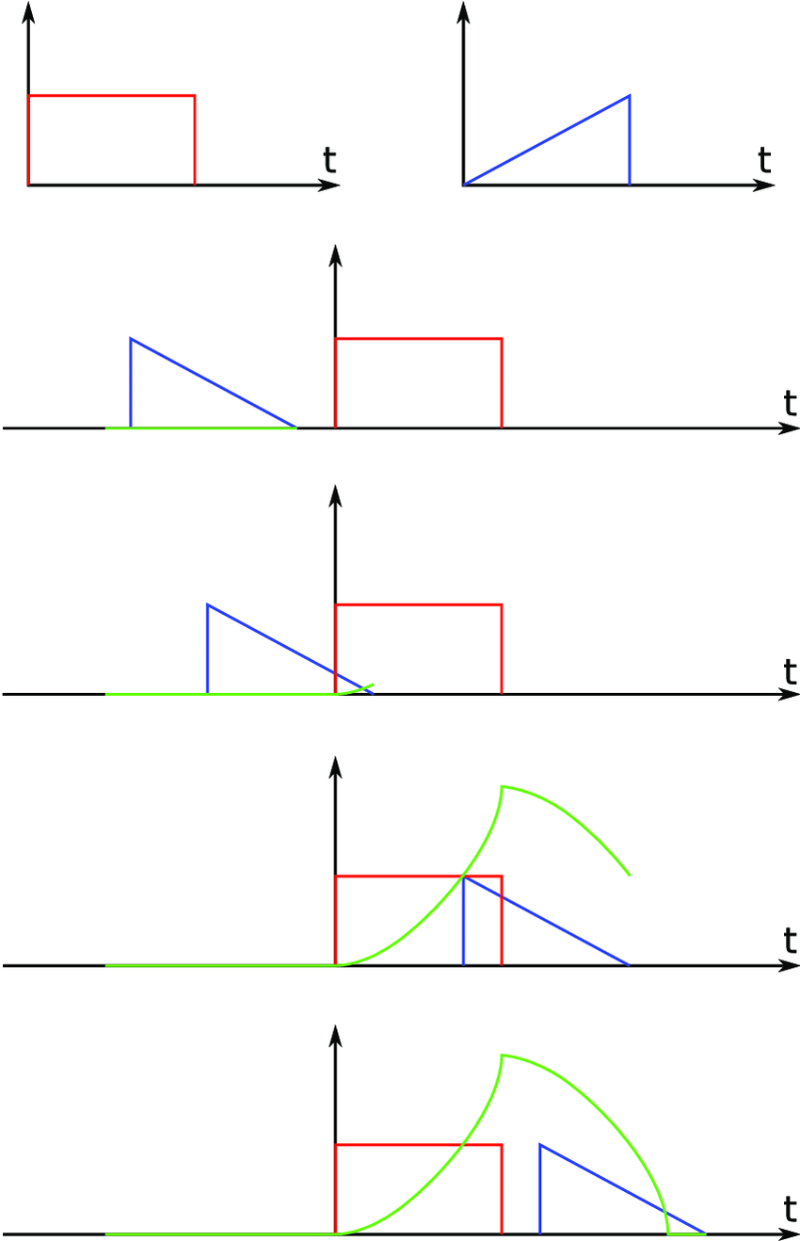
Convolution - Signals
Mathematical operation between two functions that describes how the shape of the first is modified by the other.
t = -5

Slide 32
Convolution - Signals
Mathematical operation between two functions that describes how the shape of the first is modified by the other.
t = -5
t = 3

Slide 33
Convolution - Signals
Mathematical operation between two functions that describes how the shape of the first is modified by the other.
t = -5
t = 3
t = 15

Slide 34
Convolution - Signals
Mathematical operation between two functions that describes how the shape of the first is modified by the other.
t = -5
t = 3
t = 15
Signals convolution
t = 25

Slide 35

Convolution - Signals
Mathematical operation between two functions that describes how the shape of the first is modified by the other.
t = -5
t = 3
t = 15
Signals convolution
t = 25

Slide 36
Convolution – Our vectors
Result of performing the multiplication between our vector and a smaller vector called kernel along the whole vector.
This kernel defines the importance of each cell being used in that iteration.

Slide 37
Convolution – Our vectors
Result of performing the multiplication between our vector and a smaller vector called kernel along the whole vector.
This kernel defines the importance of each cell being used in that iteration.
Vector
0 | 3 | 5 | 7 | 6 | 5 | 8 | 12 | 15 | 14

Slide 38
Convolution – Our vectors
Result of performing the multiplication between our vector and a smaller vector called kernel along the whole vector.
This kernel defines the importance of each cell being used in that iteration.
Vector
0 | 3 | 5 | 7 | 6 | 5 | 8 | 12 | 15 | 14
Kernel
1 | 1 | 1

Slide 39
Convolution – Our vectors
Kernel
1 | 1 | 1
Result of performing the multiplication between our vector and a smaller vector called kernel along the whole vector.
This kernel defines the importance of each cell being used in that iteration.
Iteration 1
0 | 3 | 5 | 7 | 6 | 5 | 8 | 12 | 15 | 14

Slide 40
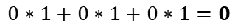
Convolution – Our vectors
Kernel
1 | 1 | 1
Result of performing the multiplication between our vector and a smaller vector called kernel along the whole vector.
This kernel defines the importance of each cell being used in that iteration.
Iteration 1
$$0∗1+0∗1+0∗1=0$$
0 | 3 | 5 | 7 | 6 | 5 | 8 | 12 | 15 | 14

Slide 41
Convolution – Our vectors
Kernel
1 | 1 | 1
Result of performing the multiplication between our vector and a smaller vector called kernel along the whole vector.
This kernel defines the importance of each cell being used in that iteration.
Iteration 1
$$0∗1+0∗1+0∗1=0$$
0 | 3 | 5 | 7 | 6 | 5 | 8 | 12 | 15 | 14
Output vector
0

Slide 42
Convolution – Our vectors
Kernel
1 | 1 | 1
Result of performing the multiplication between our vector and a smaller vector called kernel along the whole vector.
This kernel defines the importance of each cell being used in that iteration.
Iteration 1
$$0∗1+0∗1+0∗1=0$$
0 | 3 | 5 | 7 | 6 | 5 | 8 | 12 | 15 | 14
Output vector
Iteration 2
0
0 | 3 | 5 | 7 | 6 | 5 | 8 | 12 | 15 | 14

Slide 43
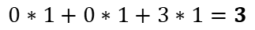
Convolution – Our vectors
Kernel
1 | 1 | 1
Result of performing the multiplication between our vector and a smaller vector called kernel along the whole vector.
This kernel defines the importance of each cell being used in that iteration.
Iteration 1
$$0∗1+0∗1+0∗1=0$$
0 | 3 | 5 | 7 | 6 | 5 | 8 | 12 | 15 | 14
Output vector
Iteration 2
0
0 | 3 | 5 | 7 | 6 | 5 | 8 | 12 | 15 | 14
$$0∗1+0∗1+3∗1=3$$

Slide 44
Convolution – Our vectors
Kernel
1 | 1 | 1
Result of performing the multiplication between our vector and a smaller vector called kernel along the whole vector.
This kernel defines the importance of each cell being used in that iteration.
Iteration 1
$$0∗1+0∗1+0∗1=0$$
0 | 3 | 5 | 7 | 6 | 5 | 8 | 12 | 15 | 14
Output vector
Iteration 2
0
0 | 3 | 5 | 7 | 6 | 5 | 8 | 12 | 15 | 14
$$0∗1+0∗1+3∗1=3$$
Output vector
0 | 3

Slide 45
Convolution – Our vectors
Kernel
1 | 1 | 1
Result of performing the multiplication between our vector and a smaller vector called kernel along the whole vector.
This kernel defines the importance of each cell being used in that iteration.
Iteration 1
$$0∗1+0∗1+0∗1=0$$
0 | 3 | 5 | 7 | 6 | 5 | 8 | 12 | 15 | 14
Output vector
Iteration 2
0
0 | 3 | 5 | 7 | 6 | 5 | 8 | 12 | 15 | 14
$$0∗1+0∗1+3∗1=3$$
Output vector
Iteration 3
0 | 3
0 | 3 | 5 | 7 | 6 | 5 | 8 | 12 | 15 | 14

Slide 46
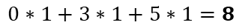
Convolution – Our vectors
Kernel
1 | 1 | 1
Result of performing the multiplication between our vector and a smaller vector called kernel along the whole vector.
This kernel defines the importance of each cell being used in that iteration.
Iteration 1
$$0∗1+0∗1+0∗1=0$$
0 | 3 | 5 | 7 | 6 | 5 | 8 | 12 | 15 | 14
Output vector
Iteration 2
0
0 | 3 | 5 | 7 | 6 | 5 | 8 | 12 | 15 | 14
$$0∗1+0∗1+3∗1=3$$
Output vector
Iteration 3
0 | 3
0 | 3 | 5 | 7 | 6 | 5 | 8 | 12 | 15 | 14
$$0∗1+3∗1+5∗1=8$$

Slide 47
Convolution – Our vectors
Kernel
1 | 1 | 1
Result of performing the multiplication between our vector and a smaller vector called kernel along the whole vector.
This kernel defines the importance of each cell being used in that iteration.
Iteration 1
$$0∗1+0∗1+0∗1=0$$
0 | 3 | 5 | 7 | 6 | 5 | 8 | 12 | 15 | 14
Output vector
Iteration 2
0
0 | 3 | 5 | 7 | 6 | 5 | 8 | 12 | 15 | 14
$$0∗1+0∗1+3∗1=3$$
Output vector
Iteration 3
0 | 3
0 | 3 | 5 | 7 | 6 | 5 | 8 | 12 | 15 | 14
$$0∗1+3∗1+5∗1=8$$
Output vector
0 | 3 | 8

Slide 48
Convolution – Our vectors
Kernel
1 | 1 | 1
Iteration 4
0 | 3 | 5 | 7 | 6 | 5 | 8 | 12 | 15 | 14

Slide 49
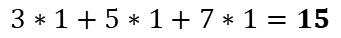
Convolution – Our vectors
Kernel
1 | 1 | 1
Iteration 4
$$3∗1+5∗1+7∗1=15$$
0 | 3 | 5 | 7 | 6 | 5 | 8 | 12 | 15 | 14
Output vector
0 | 3 | 8 | 15

Slide 50
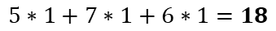
Convolution – Our vectors
Kernel
1 | 1 | 1
Iteration 4
$$3∗1+5∗1+7∗1=15$$
0 | 3 | 5 | 7 | 6 | 5 | 8 | 12 | 15 | 14
Output vector
0 | 3 | 8 | 15
Iteration 5
0 | 3 | 5 | 7 | 6 | 5 | 8 | 12 | 15 | 14
$$5∗1+7∗1+6∗1=18$$
Output vector
0 | 3 | 8 | 15 | 18

Slide 51
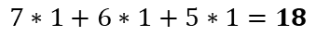
Convolution – Our vectors
Kernel
1 | 1 | 1
Iteration 4
$$3∗1+5∗1+7∗1=15$$
0 | 3 | 5 | 7 | 6 | 5 | 8 | 12 | 15 | 14
Output vector
0 | 3 | 8 | 15
Iteration 5
0 | 3 | 5 | 7 | 6 | 5 | 8 | 12 | 15 | 14
$$5∗1+7∗1+6∗1=18$$
Output vector
0 | 3 | 8 | 15 | 18
Iteration 6
0 | 3 | 5 | 7 | 6 | 5 | 8 | 12 | 15 | 14
$$7∗1+6∗1+5∗1=18$$
Output vector
0 | 3 | 8 | 15 | 18 | 18

Slide 52
Convolution – Our vectors
Kernel
1 | 1 | 1
Iteration 4
$$3∗1+5∗1+7∗1=15$$
0 | 3 | 5 | 7 | 6 | 5 | 8 | 12 | 15 | 14
Output vector
0 | 3 | 8 | 15
Iteration 5
0 | 3 | 5 | 7 | 6 | 5 | 8 | 12 | 15 | 14
$$5∗1+7∗1+6∗1=18$$
Output vector
0 | 3 | 8 | 15 | 18
Iteration 6
0 | 3 | 5 | 7 | 6 | 5 | 8 | 12 | 15 | 14
$$7∗1+6∗1+5∗1=18$$
Output vector
0 | 3 | 8 | 15 | 18 | 18

Slide 53
Convolution – Our vectors
Kernel
-1 | 5 | -1

Slide 54
Convolution – Our vectors
Kernel
-1 | 5 | -1
Iteration 4
$$3∗−1+5∗5+7∗−1=15$$
0 | 3 | 5 | 7 | 6 | 5 | 8 | 12 | 15 | 14
Output vector
- | - | - | 15

Slide 55
Convolution – Our vectors
Kernel
-1 | 5 | -1
Iteration 4
$$3∗−1+5∗5+7∗−1=15$$
0 | 3 | 5 | 7 | 6 | 5 | 8 | 12 | 15 | 14
Output vector
- | - | - | 15
Iteration 5
0 | 3 | 5 | 7 | 6 | 5 | 8 | 12 | 15 | 14
$$5∗−1+7∗5+6∗−1=24$$
Output vector
- | - | - | 15 | 24

Slide 56
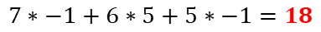
Convolution – Our vectors
Kernel
-1 | 5 | -1
Iteration 4
$$3∗−1+5∗5+7∗−1=15$$
0 | 3 | 5 | 7 | 6 | 5 | 8 | 12 | 15 | 14
Output vector
- | - | - | 15
Iteration 5
0 | 3 | 5 | 7 | 6 | 5 | 8 | 12 | 15 | 14
$$5∗−1+7∗5+6∗−1=24$$
Output vector
- | - | - | 15 | 24
Iteration 6
0 | 3 | 5 | 7 | 6 | 5 | 8 | 12 | 15 | 14
$$7∗−1+6∗5+5∗−1=18$$
Output vector
- | - | - | 15 | 24 | 18

Slide 57
Convolution – Our vectors
Kernel
-1 | 5 | -1
Iteration 4
$$3∗−1+5∗5+7∗−1=15$$
0 | 3 | 5 | 7 | 6 | 5 | 8 | 12 | 15 | 14
Output vector
- | - | - | 15
Iteration 5
0 | 3 | 5 | 7 | 6 | 5 | 8 | 12 | 15 | 14
$$5∗−1+7∗5+6∗−1=24$$
Output vector
- | - | - | 15 | 24
Iteration 6
0 | 3 | 5 | 7 | 6 | 5 | 8 | 12 | 15 | 14
$$7∗−1+6∗5+5∗−1=18$$
Output vector
- | - | - | 15 | 24 | 18
0 | 3 | 8 | 15 | 18 | 18

Slide 58
Convolution – Images
Just adding 1 dimension for binary or single color!

Slide 59
Convolution – Images
Just adding 1 dimension for binary or single color!
1 | -1 | -1 | -1 | -1 | -1 | 1
-1 | 1 | -1 | -1 | -1 | 1 | -1
-1 | -1 | 1 | -1 | 1 | -1 | -1
-1 | -1 | -1 | 1 | -1 | -1 | -1
-1 | -1 | 1 | -1 | 1 | -1 | -1
-1 | 1 | -1 | -1 | -1 | 1 | -1
1 | -1 | -1 | -1 | -1 | -1 | 1

Slide 60
Convolution – Images
1 | -1 | -1
-1 | 1 | -1
-1 | -1 | 1
Kernel
Just adding 1 dimension for binary or single color!
1 | -1 | -1 | -1 | -1 | -1 | 1
-1 | 1 | -1 | -1 | -1 | 1 | -1
-1 | -1 | 1 | -1 | 1 | -1 | -1
-1 | -1 | -1 | 1 | -1 | -1 | -1
-1 | -1 | 1 | -1 | 1 | -1 | -1
-1 | 1 | -1 | -1 | -1 | 1 | -1
1 | -1 | -1 | -1 | -1 | -1 | 1

Slide 61
Convolution – Images
1 | -1 | -1
-1 | 1 | -1
-1 | -1 | 1
Kernel
Just adding 1 dimension for binary or single color!
1 | -1 | -1 | -1 | -1 | -1 | 1
-1 | 1 | -1 | -1 | -1 | 1 | -1
-1 | -1 | 1 | -1 | 1 | -1 | -1
-1 | -1 | -1 | 1 | -1 | -1 | -1
-1 | -1 | 1 | -1 | 1 | -1 | -1
-1 | 1 | -1 | -1 | -1 | 1 | -1
1 | -1 | -1 | -1 | -1 | -1 | 1

Slide 62
Convolution – Images
1 | -1 | -1
-1 | 1 | -1
-1 | -1 | 1
Kernel
Just adding 1 dimension for binary or single color!
1 | -1 | -1 | -1 | -1 | -1 | 1
-1 | 1 | -1 | -1 | -1 | 1 | -1
-1 | -1 | 1 | -1 | 1 | -1 | -1
-1 | -1 | -1 | 1 | -1 | -1 | -1
-1 | -1 | 1 | -1 | 1 | -1 | -1
-1 | 1 | -1 | -1 | -1 | 1 | -1
1 | -1 | -1 | -1 | -1 | -1 | 1
1

Slide 63
Convolution – Images
1 | -1 | -1
-1 | 1 | -1
-1 | -1 | 1
Kernel
Just adding 1 dimension for binary or single color!
1 | -1 | -1 | -1 | -1 | -1 | 1
-1 | 1 | -1 | -1 | -1 | 1 | -1
-1 | -1 | 1 | -1 | 1 | -1 | -1
-1 | -1 | -1 | 1 | -1 | -1 | -1
-1 | -1 | 1 | -1 | 1 | -1 | -1
-1 | 1 | -1 | -1 | -1 | 1 | -1
1 | -1 | -1 | -1 | -1 | -1 | 1
1

Slide 64
Convolution – Images
1 | -1 | -1
-1 | 1 | -1
-1 | -1 | 1
Kernel
Just adding 1 dimension for binary or single color!
1 | -1 | -1 | -1 | -1 | -1 | 1
-1 | 1 | -1 | -1 | -1 | 1 | -1
-1 | -1 | 1 | -1 | 1 | -1 | -1
-1 | -1 | -1 | 1 | -1 | -1 | -1
-1 | -1 | 1 | -1 | 1 | -1 | -1
-1 | 1 | -1 | -1 | -1 | 1 | -1
1 | -1 | -1 | -1 | -1 | -1 | 1
1 | -0.1

Slide 65
Convolution – Images
1 | -1 | -1
-1 | 1 | -1
-1 | -1 | 1
Kernel
Just adding 1 dimension for binary or single color!
1 | -1 | -1 | -1 | -1 | -1 | 1
-1 | 1 | -1 | -1 | -1 | 1 | -1
-1 | -1 | 1 | -1 | 1 | -1 | -1
-1 | -1 | -1 | 1 | -1 | -1 | -1
-1 | -1 | 1 | -1 | 1 | -1 | -1
-1 | 1 | -1 | -1 | -1 | 1 | -1
1 | -1 | -1 | -1 | -1 | -1 | 1
1 | -0.1

Slide 66
Convolution – Images
1 | -1 | -1
-1 | 1 | -1
-1 | -1 | 1
Kernel
Just adding 1 dimension for binary or single color!
1 | -1 | -1 | -1 | -1 | -1 | 1
-1 | 1 | -1 | -1 | -1 | 1 | -1
-1 | -1 | 1 | -1 | 1 | -1 | -1
-1 | -1 | -1 | 1 | -1 | -1 | -1
-1 | -1 | 1 | -1 | 1 | -1 | -1
-1 | 1 | -1 | -1 | -1 | 1 | -1
1 | -1 | -1 | -1 | -1 | -1 | 1
1 | -0.1 | 0.33

Slide 67
Convolution – Images
1 | -1 | -1
-1 | 1 | -1
-1 | -1 | 1
Kernel
Just adding 1 dimension for binary or single color!
1 | -1 | -1 | -1 | -1 | -1 | 1
-1 | 1 | -1 | -1 | -1 | 1 | -1
-1 | -1 | 1 | -1 | 1 | -1 | -1
-1 | -1 | -1 | 1 | -1 | -1 | -1
-1 | -1 | 1 | -1 | 1 | -1 | -1
-1 | 1 | -1 | -1 | -1 | 1 | -1
1 | -1 | -1 | -1 | -1 | -1 | 1
1 | -0.1 | 0.33 | -0.11

Slide 68
Convolution – Images
1 | -1 | -1
-1 | 1 | -1
-1 | -1 | 1
Kernel
Just adding 1 dimension for binary or single color!
1 | -1 | -1 | -1 | -1 | -1 | 1
-1 | 1 | -1 | -1 | -1 | 1 | -1
-1 | -1 | 1 | -1 | 1 | -1 | -1
-1 | -1 | -1 | 1 | -1 | -1 | -1
-1 | -1 | 1 | -1 | 1 | -1 | -1
-1 | 1 | -1 | -1 | -1 | 1 | -1
1 | -1 | -1 | -1 | -1 | -1 | 1
1 | -0.1 | 0.33 | -0.11 | 0.11

Slide 69
Convolution – Images
1 | -1 | -1
-1 | 1 | -1
-1 | -1 | 1
Kernel
Just adding 1 dimension for binary or single color!
1 | -1 | -1 | -1 | -1 | -1 | 1
-1 | 1 | -1 | -1 | -1 | 1 | -1
-1 | -1 | 1 | -1 | 1 | -1 | -1
-1 | -1 | -1 | 1 | -1 | -1 | -1
-1 | -1 | 1 | -1 | 1 | -1 | -1
-1 | 1 | -1 | -1 | -1 | 1 | -1
1 | -1 | -1 | -1 | -1 | -1 | 1
1 | -0.1 | 0.33 | -0.11 | 0.11
-0.11

Slide 70
Convolution – Images
1 | -1 | -1
-1 | 1 | -1
-1 | -1 | 1
Kernel
Just adding 1 dimension for binary or single color!
1 | -1 | -1 | -1 | -1 | -1 | 1
-1 | 1 | -1 | -1 | -1 | 1 | -1
-1 | -1 | 1 | -1 | 1 | -1 | -1
-1 | -1 | -1 | 1 | -1 | -1 | -1
-1 | -1 | 1 | -1 | 1 | -1 | -1
-1 | 1 | -1 | -1 | -1 | 1 | -1
1 | -1 | -1 | -1 | -1 | -1 | 1
1 | -0.1 | 0.33 | -0.11 | 0.11
-0.11 | 1

Slide 71
Convolution – Images
1 | -1 | -1
-1 | 1 | -1
-1 | -1 | 1
Kernel
Just adding 1 dimension for binary or single color!
1 | -1 | -1 | -1 | -1 | -1 | 1
-1 | 1 | -1 | -1 | -1 | 1 | -1
-1 | -1 | 1 | -1 | 1 | -1 | -1
-1 | -1 | -1 | 1 | -1 | -1 | -1
-1 | -1 | 1 | -1 | 1 | -1 | -1
-1 | 1 | -1 | -1 | -1 | 1 | -1
1 | -1 | -1 | -1 | -1 | -1 | 1
1 | -0.1 | 0.33 | -0.11 | 0.11
-0.11 | 1 | ... | ... | ...
... | ... | ... | ... | ...
... | ... | ... | 1 | ...
... | ... | ... | ... | 1

Slide 72
Convolution – Images
1 | -1 | -1
-1 | 1 | -1
-1 | -1 | 1
Kernel
Just adding 1 dimension for binary or single color!
1 | -1 | -1 | -1 | -1 | -1 | 1
-1 | 1 | -1 | -1 | -1 | 1 | -1
-1 | -1 | 1 | -1 | 1 | -1 | -1
-1 | -1 | -1 | 1 | -1 | -1 | -1
-1 | -1 | 1 | -1 | 1 | -1 | -1
-1 | 1 | -1 | -1 | -1 | 1 | -1
1 | -1 | -1 | -1 | -1 | -1 | 1
1 | -0.1 | 0.33 | -0.11 | 0.11
-0.11 | 1 | ... | ... | ...
... | ... | ... | ... | ...
... | ... | ... | 1 | ...
... | ... | ... | ... | 1
(5, 5)
(7, 7)

Slide 73
Convolution – Sobel filters
-1 | 0 | 1
-2 | 0 | 2
-1 | 0 | 1
1 | 2 | 1
0 | 0 | 0
-1 | -2 | -1
Gx
Gy

Slide 74
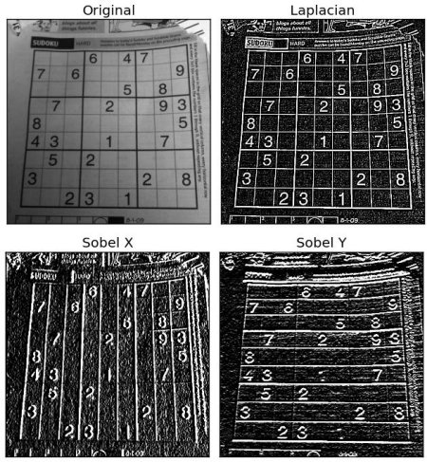
Convolution – Sobel filters
-1 | 0 | 1
-2 | 0 | 2
-1 | 0 | 1
1 | 2 | 1
0 | 0 | 0
-1 | -2 | -1
Gx
Gy

Slide 75
Convolution – Sobel filters
-1 | 0 | 1
-2 | 0 | 2
-1 | 0 | 1
1 | 2 | 1
0 | 0 | 0
-1 | -2 | -1
Gx
Gy
Sobel operator

Slide 76
Convolution – Sobel filters
-1 | 0 | 1
-2 | 0 | 2
-1 | 0 | 1
1 | 2 | 1
0 | 0 | 0
-1 | -2 | -1
Gx
Gy
Sobel operator
https://docs.opencv.org/3.4/d2/d2c/tutorial_sobel_derivatives.html

Slide 77
Layers

Slide 78
Convolution – 1D Layer
layer = tf.keras.layers.Conv1D(1, 3, input_shape=input_shape)

Slide 79
Convolution – 1D Layer
layer = tf.keras.layers.Conv1D(1, 3, input_shape=input_shape)
Neurons per layer

Slide 80
Convolution – 1D Layer
layer = tf.keras.layers.Conv1D(1, 3, input_shape=input_shape)
Neurons per layer
Kernel size

Slide 81
Convolution – 1D Layer
layer = tf.keras.layers.Conv1D(1, 3, input_shape=input_shape)
Neurons per layer
Kernel size
Vector shape

Slide 82
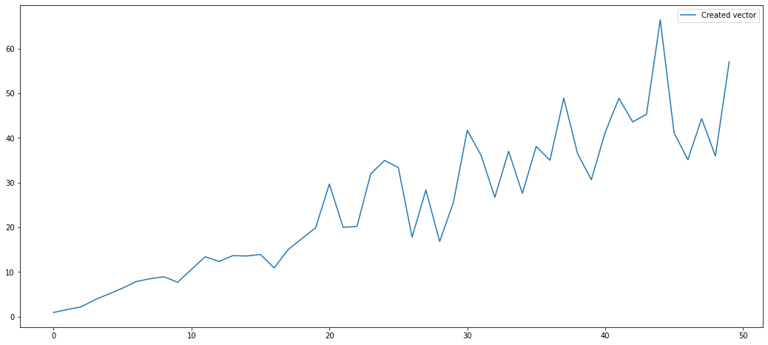
Convolution – 1D Layer
layer = tf.keras.layers.Conv1D(1, 3, input_shape=input_shape)
Neurons per layer
Kernel size
Vector shape

Slide 83
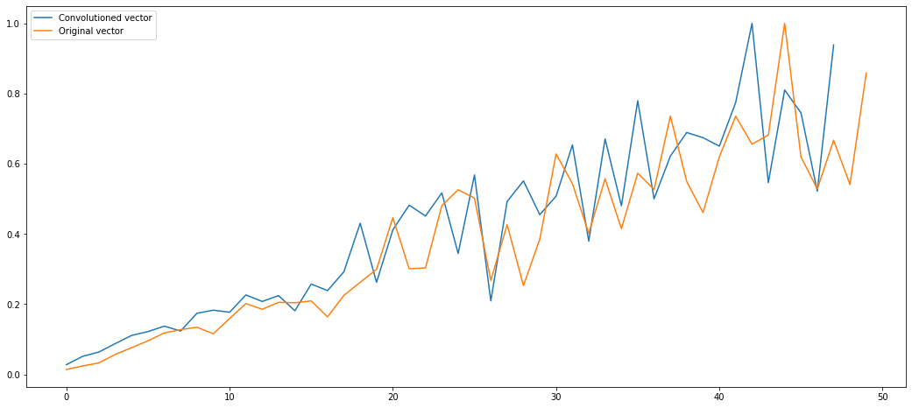
Convolution – 1D Layer
layer = tf.keras.layers.Conv1D(1, 3, input_shape=input_shape)
Neurons per layer
Kernel size
Vector shape

Slide 84
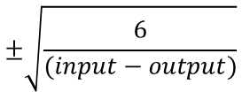
Convolution – 1D Layer
layer = tf.keras.layers.Conv1D(1, 3, input_shape=input_shape)
Neurons per layer
Kernel size
Vector shape
Kernel has a default initialization called glorot
$$±\sqrt{\frac{6}{(input−output)}}$$

Slide 85
Convolution – 2D Layer
layers.Conv2D(3, 3, input_shape=(427, 640, 1))

Slide 86
Convolution – 2D Layer
layers.Conv2D(3, 3, input_shape=(427, 640, 1))
Neurons per layer

Slide 87
Convolution – 2D Layer
layers.Conv2D(3, 3, input_shape=(427, 640, 1))
Neurons per layer
Kernel size

Slide 88
Convolution – 2D Layer
layers.Conv2D(3, 3, input_shape=(427, 640, 1))
Neurons per layer
Kernel size
X pixel size
Y pixel size

Slide 89
Convolution – 2D Layer
layers.Conv2D(3, 3, input_shape=(427, 640, 1))
Neurons per layer
Kernel size
X pixel size
Y pixel size
Dimensions

Slide 90
Convolution – 2D Layer
Binary/Black & white images
layers.Conv2D(3, 3, input_shape=(427, 640, 1))
Neurons per layer
Kernel size
X pixel size
Y pixel size
Dimensions

Slide 91
Convolution – 2D Layer
Binary/Black & white images
layers.Conv2D(3, 3, input_shape=(427, 640, 1))
Neurons per layer
Kernel size
X pixel size
Y pixel size
Dimensions
Coloured images
layers.Conv2D(3, 3, input_shape=(427, 640, 3))
Dimensions (RGB)

Slide 92
Convolution – 2D Layer to images

Slide 93
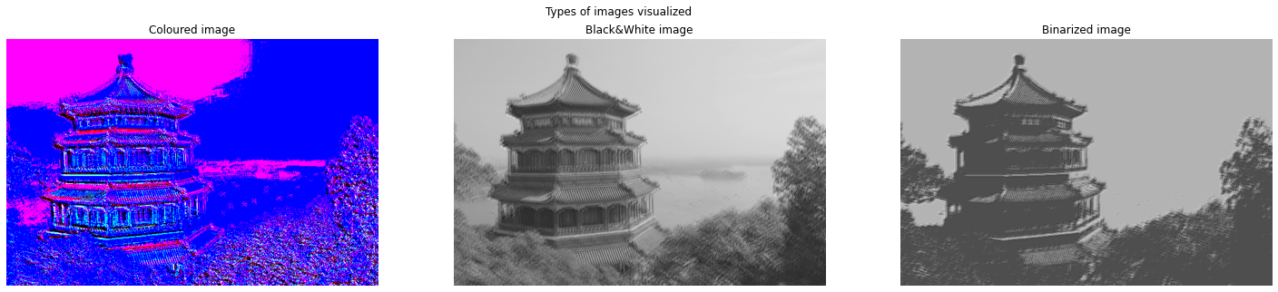
Convolution – 2D Layer to images

Slide 94
Convolution – 2D Layer to images

Slide 95
Convolution – 2D Layer to images

Slide 96
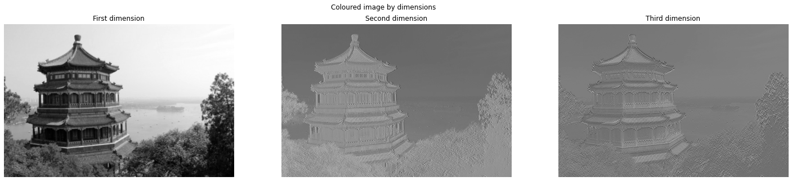
Convolution – 2D Layer to images

Slide 97
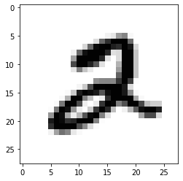
Convolution – 2D Layer to simple image
(28, 28)

Slide 98
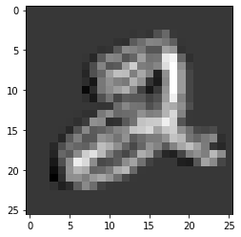
Convolution – 2D Layer to simple image
(28, 28)

Slide 99
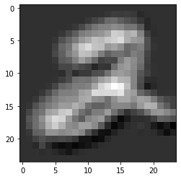
Convolution – 2D Layer to simple image
(28, 28)

Slide 100
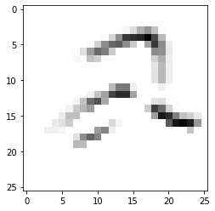
Convolution – 2D Layer to simple image
(28, 28)

Slide 101
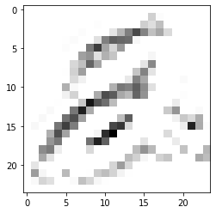
Convolution – 2D Layer to simple image
(28, 28)

Slide 102
Convolution – 2D Layer to simple image
(28, 28)
layers.Conv2D(1, 3, activation='relu', input_shape=(28, 28, 1))
layers.Conv2D(1, 5, activation='relu', input_shape=(28, 28, 1))

Slide 103
Convolution – 2D Layer to simple image
(26, 26)
(24, 24)
(28, 28)
layers.Conv2D(1, 3, activation='relu', input_shape=(28, 28, 1))
layers.Conv2D(1, 5, activation='relu', input_shape=(28, 28, 1))

Slide 104
Convolution – 2D Layer to simple image
(26, 26)
(24, 24)
(28, 28)
layers.Conv2D(1, 3, activation='relu', input_shape=(28, 28, 1))
layers.Conv2D(1, 5, activation='relu', input_shape=(28, 28, 1))

Slide 105
Convolution – 2D Layer to simple image
(26, 26)
(24, 24)
(28, 28)
layers.Conv2D(1, 3, activation='relu', input_shape=(28, 28, 1))
layers.Conv2D(1, 5, activation='relu', input_shape=(28, 28, 1))

Slide 106


Hands on!
Day-2 Convolution notebooks

Slide 107
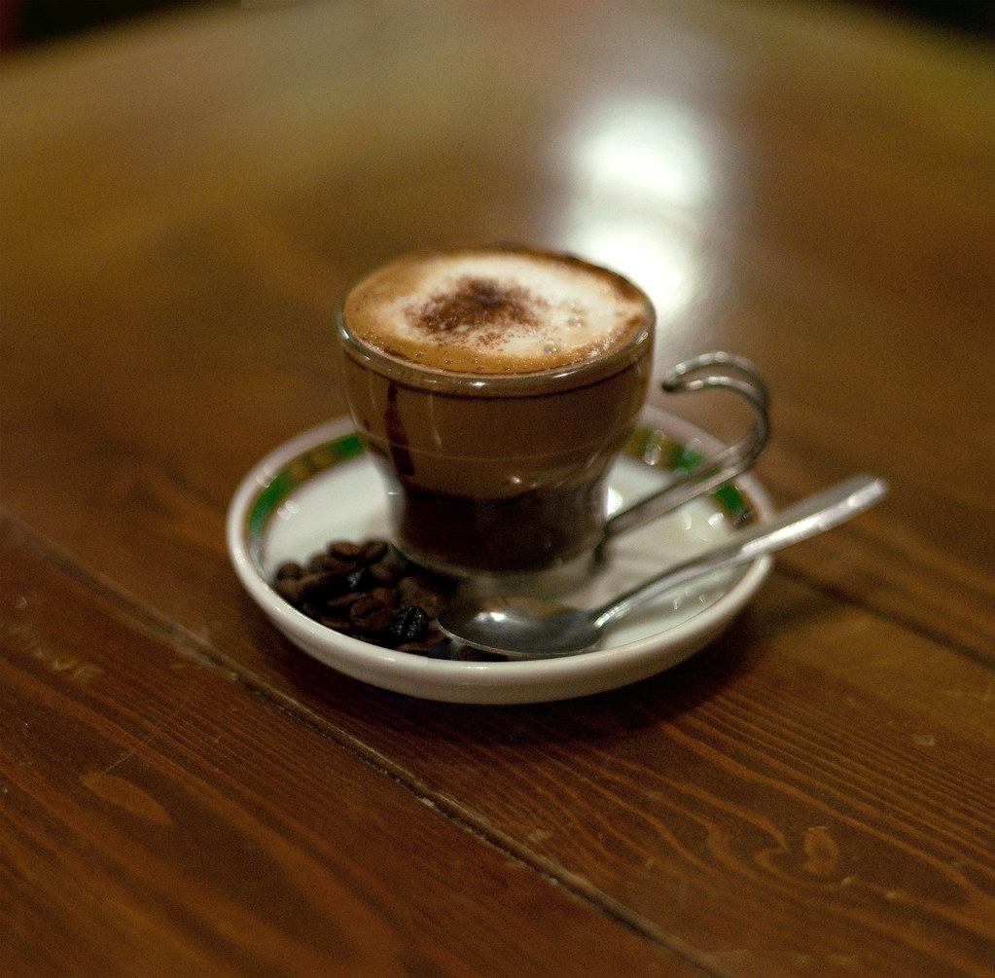
Coffee break

Slide 108
Architectures for networks

Slide 109

Architecture – General usage

Slide 110
Architecture – General usage

Slide 111
Architecture – General usage

Slide 112
Architecture – General usage

Slide 113
Architecture – Other usages
(Conv2DTranspose)

Slide 114
Architecture – Other usages
(Conv2DTranspose)

Slide 115
Architecture – Pooling

Slide 116
Architecture – Pooling
Layer used for reduce dimensionality more aggressively than just performing convolution and summarizes the information.

Slide 117
Architecture – Pooling
Layer used for reduce dimensionality more aggressively than just performing convolution and summarizes the information.
1 | 1 | 2 | 4
5 | 6 | 7 | 8
3 | 2 | 1 | 0
1 | 2 | 3 | 4

Slide 118
Architecture – Pooling
Layer used for reduce dimensionality more aggressively than just performing convolution and summarizes the information.
2x2 Pooling filter
1 | 1 | 2 | 4
5 | 6 | 7 | 8
3 | 2 | 1 | 0
1 | 2 | 3 | 4

Slide 119
Architecture – Pooling
Layer used for reduce dimensionality more aggressively than just performing convolution and summarizes the information.
2x2 Pooling filter
1 | 1 | 2 | 4
5 | 6 | 7 | 8
3 | 2 | 1 | 0
1 | 2 | 3 | 4
Max
Average

Slide 120
Architecture – Pooling
Layer used for reduce dimensionality more aggressively than just performing convolution and summarizes the information.
2x2 Pooling filter
1 | 1 | 2 | 4
5 | 6 | 7 | 8
3 | 2 | 1 | 0
1 | 2 | 3 | 4
Max
Average

Slide 121
Architecture – Pooling
Layer used for reduce dimensionality more aggressively than just performing convolution and summarizes the information.
2x2 Pooling filter
1 | 1 | 2 | 4
5 | 6 | 7 | 8
3 | 2 | 1 | 0
1 | 2 | 3 | 4
Max
Average
6
3.25

Slide 122
Architecture – Pooling
Layer used for reduce dimensionality more aggressively than just performing convolution and summarizes the information.
2x2 Pooling filter
1 | 1 | 2 | 4
5 | 6 | 7 | 8
3 | 2 | 1 | 0
1 | 2 | 3 | 4
Max
Average
6
3.25

Slide 123
Architecture – Pooling
Layer used for reduce dimensionality more aggressively than just performing convolution and summarizes the information.
2x2 Pooling filter
1 | 1 | 2 | 4
5 | 6 | 7 | 8
3 | 2 | 1 | 0
1 | 2 | 3 | 4
Max
Average
6 | 8
3.25 | 5.25

Slide 124
Architecture – Pooling
Layer used for reduce dimensionality more aggressively than just performing convolution and summarizes the information.
2x2 Pooling filter
1 | 1 | 2 | 4
5 | 6 | 7 | 8
3 | 2 | 1 | 0
1 | 2 | 3 | 4
Max
Average
6 | 8
3.25 | 5.25

Slide 125
Architecture – Pooling
Layer used for reduce dimensionality more aggressively than just performing convolution and summarizes the information.
2x2 Pooling filter
1 | 1 | 2 | 4
5 | 6 | 7 | 8
3 | 2 | 1 | 0
1 | 2 | 3 | 4
Max
Average
6 | 8
3
3.25 | 5.25
2

Slide 126
Architecture – Pooling
Layer used for reduce dimensionality more aggressively than just performing convolution and summarizes the information.
2x2 Pooling filter
1 | 1 | 2 | 4
5 | 6 | 7 | 8
3 | 2 | 1 | 0
1 | 2 | 3 | 4
Max
Average
6 | 8
3
3.25 | 5.25
2

Slide 127
Architecture – Pooling
Layer used for reduce dimensionality more aggressively than just performing convolution and summarizes the information.
2x2 Pooling filter
1 | 1 | 2 | 4
5 | 6 | 7 | 8
3 | 2 | 1 | 0
1 | 2 | 3 | 4
Max
Average
6 | 8
3 | 4
3.25 | 5.25
2 | 2

Slide 128
Architecture – General usage

Slide 129
Architecture – General usage
Why do we need this dense structure at the end of convolution layers?

Slide 130
Architecture – General usage
Why do we need this dense structure at the end of convolution layers?
Create knowledge from the reduced matrices.

Slide 131
Architecture – General usage
Up until now, we’ve seen all the sections independently:
Today: Convolutions & Pooling

Slide 132
Architecture – General usage
Up until now, we’ve seen all the sections independently:
Today: Convolutions & Pooling
Yesterday: Dense networks

Slide 133
Architecture – General usage
Up until now, we’ve seen all the sections independently:
Inputs & outputs
Today: Convolutions & Pooling
Yesterday: Dense networks

Slide 134
Architecture – Activation function
We’ve seen and used them but how do they affect our information?

Slide 135
Architecture – Activation function
We’ve seen and used them but how do they affect our information?
0.6 | 5 | 3 | -4
-0.7 | 6 | 7 | 0.8
-2 | -1 | 2.4 | -2
1 | 2 | 3 | 4

Slide 136
Architecture – Activation function
We’ve seen and used them but how do they affect our information?
0.6 | 5 | 3 | -4
-0.7 | 6 | 7 | 0.8
-2 | -1 | 2.4 | -2
1 | 2 | 3 | 4

Slide 137
Architecture – Activation function
We’ve seen and used them but how do they affect our information?
0.6 | 5 | 3 | -4
-0.7 | 6 | 7 | 0.8
-2 | -1 | 2.4 | -2
1 | 2 | 3 | 4

Slide 138
Architecture – Activation function
We’ve seen and used them but how do they affect our information?
0.6 | 5 | 3 | -4
-0.7 | 6 | 7 | 0.8
-2 | -1 | 2.4 | -2
1 | 2 | 3 | 4

Slide 139
Architecture – Activation function
We’ve seen and used them but how do they affect our information?
0.6 | 5 | 3 | -4
-0.7 | 6 | 7 | 0.8
-2 | -1 | 2.4 | -2
1 | 2 | 3 | 4

Slide 140
Architecture – Activation function
We’ve seen and used them but how do they affect our information?
0.6 | 5 | 3 | -4
-0.7 | 6 | 7 | 0.8
-2 | -1 | 2.4 | -2
1 | 2 | 3 | 4
0.6 | 5 | 3 | 0
0 | 6 | 7 | 0.8
0 | 0 | 2.4 | 0
1 | 2 | 3 | 4

Slide 141
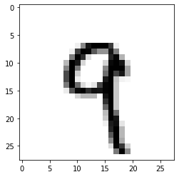
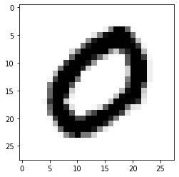
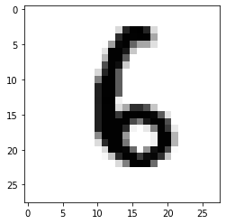
First CNN – Typical MNIST classification
Classical dataset for benchmark analysis of models. The data is structured in 60k samples in 784 features which are, in fact, pixels from images.

Slide 142
First CNN – Typical MNIST classification
Classical dataset for benchmark analysis of models. The data is structured in 60k samples in 784 features which are, in fact, pixels from images.
Our input
(28, 28, 1)

Slide 143
First CNN – Typical MNIST classification
Classical dataset for benchmark analysis of models. The data is structured in 60k samples in 784 features which are, in fact, pixels from images.
Our input
(28, 28, 1)
X, Y pixels

Slide 144
First CNN – Typical MNIST classification
Classical dataset for benchmark analysis of models. The data is structured in 60k samples in 784 features which are, in fact, pixels from images.
Our input
(28, 28, 1)
X, Y pixels
Dimension

Slide 145
First CNN – Typical MNIST classification
Classical dataset for benchmark analysis of models. The data is structured in 60k samples in 784 features which are, in fact, pixels from images.
Our input
(28, 28, 1)
X, Y pixels
Dimension

Slide 146
First CNN – Typical MNIST classification
Classical dataset for benchmark analysis of models. The data is structured in 60k samples in 784 features which are, in fact, pixels from images.
Our input
(28, 28, 1)
X, Y pixels
Dimension

Slide 147
First CNN – Typical MNIST classification
Classical dataset for benchmark analysis of models. The data is structured in 60k samples in 784 features which are, in fact, pixels from images.
Our input
(28, 28, 1)
X, Y pixels
Dimension

Slide 148
First CNN – Typical MNIST classification
Classical dataset for benchmark analysis of models. The data is structured in 60k samples in 784 features which are, in fact, pixels from images.
Our input
(28, 28, 1)
X, Y pixels
Dimension
As many as we want, free configuration (2-3 at much, dataset is too easy), using ReLu as common activation function.

Slide 149
First CNN – Typical MNIST classification
Classical dataset for benchmark analysis of models. The data is structured in 60k samples in 784 features which are, in fact, pixels from images.
Our input
(28, 28, 1)
X, Y pixels
Dimension
As many as we want, free configuration (2-3 at much, dataset is too easy), using ReLu as common activation function.

Slide 150
First CNN – Typical MNIST classification
Classical dataset for benchmark analysis of models. The data is structured in 60k samples in 784 features which are, in fact, pixels from images.
Our input
(28, 28, 1)
X, Y pixels
Dimension
As many as we want, free configuration (2-3 at much, dataset is too easy), using ReLu as common activation function.

Slide 151
First CNN – Typical MNIST classification
Classical dataset for benchmark analysis of models. The data is structured in 60k samples in 784 features which are, in fact, pixels from images.
Our input
(28, 28, 1)
X, Y pixels
Dimension
As many as we want, free configuration (2-3 at much, dataset is too easy), using ReLu as common activation function.

Slide 152
First CNN – Typical MNIST classification
Classical dataset for benchmark analysis of models. The data is structured in 60k samples in 784 features which are, in fact, pixels from images.
Our input
As many as outputs in our dataset (10) with softmax as activation function (0-1 for each class)
(28, 28, 1)
X, Y pixels
Dimension
As many as we want, free configuration (2-3 at much, dataset is too easy), using ReLu as common activation function.

Slide 153
First CNN – Typical MNIST classification
Classical dataset for benchmark analysis of models. The data is structured in 60k samples in 784 features which are, in fact, pixels from images.
Flatten from 2D to 1D
(x,y) → [x·y, ]
Our input
As many as outputs in our dataset (10) with softmax as activation function (0-1 for each class)
(28, 28, 1)
X, Y pixels
Dimension
As many as we want, free configuration (2-3 at much, dataset is too easy), using ReLu as common activation function.

Slide 154
First CNN – Typical MNIST classification
What’s left?

Slide 155
First CNN – Typical MNIST classification
What’s left?
Classes are coded by the number, therefore, having 10 neurons at the output won’t match with this.

Slide 156
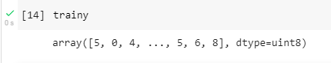
First CNN – Typical MNIST classification
What’s left?
Classes are coded by the number, therefore, having 10 neurons at the output won’t match with this.

Slide 157
First CNN – Typical MNIST classification
What’s left?
Classes are coded by the number, therefore, having 10 neurons at the output won’t match with this.
Necessary to apply one-hot encoding to fit our classes to the network.

Slide 158
First CNN – Typical MNIST classification
What’s left?
Classes are coded by the number, therefore, having 10 neurons at the output won’t match with this.
Necessary to apply one-hot encoding to fit our classes to the network.
First label (5): 5
Encoded: [0. 0. 0. 0. 0. 1. 0. 0. 0. 0.]

Slide 159
First CNN – Typical MNIST classification
Is everything done ?

Slide 160

First CNN – Typical MNIST classification
Is everything done ?

Slide 161
First CNN – Typical MNIST classification
Last steps !
Define optimizer
Train the model
Evaluate results

Slide 162
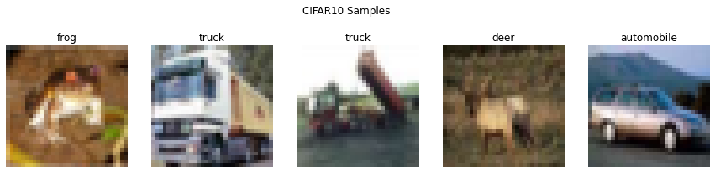
Second CNN – Coloured classification
This time we’ll be using CIFAR 10 a widely used dataset to perform colour image classification with size 32x32x3.

Slide 163
Second CNN – Coloured classification
Which steps are required ? Is something different from the previous example?

Slide 164
Second CNN – Coloured classification
Which steps are required ? Is something different from the previous example?
Input is different: from 28x28x1 to 32x32x3

Slide 165
Second CNN – Coloured classification
Which steps are required ? Is something different from the previous example?
Input is different: from 28x28x1 to 32x32x3
Images are way more complex: simpler networks might not provide good results.

Slide 166
Second CNN – Coloured classification
Which steps are required ? Is something different from the previous example?
Input is different: from 28x28x1 to 32x32x3
Images are way more complex: simpler networks might not provide good results.
Care with network size !

Slide 167
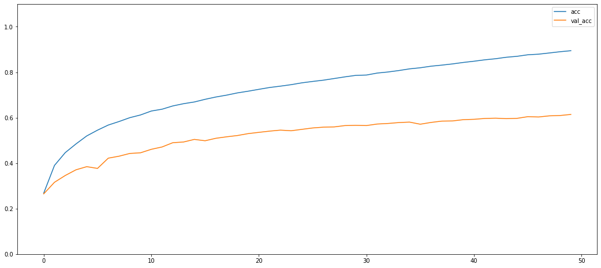
Second CNN – Coloured classification
Which steps are required ? Is something different from the previous example?
Input is different: from 28x28x1 to 32x32x3
Images are way more complex: simpler networks might not provide good results.
Care with network size !

Slide 168
Hands on!
Day-2 Convolution notebooks

Slide 169
Thanks
Do you have any questions?
Sergi.bernet@salle.url.edu

